Slide 2


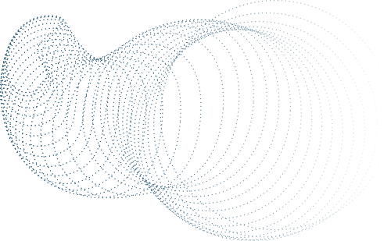



AI-BASED UPI FRAUD DETECTION
Akshat Bansal Mann Chavda Meet Dave Meet Vastani Heman Darji

Slide 3
Table of Content
Introduction
Project Overview
Load Data
Data Preprocessing
Feature Selection
Error handling
Model Training
Model Evaluation
Fraud Detection & Analysis
Fraud Visualization
Conclusion

Slide 4
Introduction
What is UPI?
Unified Payments Interface (UPI) is a digital payment system used for fast and secure money transfers.
It allows users to send and receive money instantly through their mobile phones.
Popular UPI apps: Google Pay, PhonePe, Paytm, BHIM, and banking apps.
How Can AI Help in Fraud Detection?
AI and Machine Learning analyse past transactions to detect fraud patterns.
It learns from real fraud cases and improves fraud detection over time.
AI-based fraud detection can:
Identify unusual transaction patterns.
Detect high-risk locations and devices.
Flag suspicious transactions before they happen.

Slide 5
Project Objective
Key Objectives of the UPI Fraud Detection System
Identify fraudulent transactions using past UPI transaction data.
Train machine learning models to classify transactions as fraudulent or legitimate with high accuracy.
Analyze fraud trends to detect patterns such as unusual transaction amounts, locations, or times.
Visualize fraud risks using interactive charts and graphs for better understanding.
Implementing multiple fraud detection techniques and using supervised learning to detect any unusual transactions.
Generate fraud reports and insights, providing details on high-risk transaction types, locations, and users.

Slide 6

Load data
Data Preprocessing
Feature Selection
Error handling
Model Training
Load Data
What data do we need?
We use a dataset containing past UPI transactions in a CSV file.
Key Features in the Dataset:
Transaction ID – Unique identifier for each transaction.
Amount – The value of the transaction.
Transaction Type – P2P (Person-to-Person), Merchant, Bill Payment, etc.
Device Type – Mobile, Tablet, etc.
Location – City and state where the transaction occurred.
Transaction Status – Success or Failure.
Fraud Label – (1 = Fraud, 0 = Legitimate).
How do we load the data?
We use Python and Pandas to load the CSV file into a Data Frame for further analysis.

Slide 7
Load data
Data Preprocessing
Feature Selection
Error handling
Model Training
Data Preprocessing
Why is Preprocessing Important?
The dataset may have missing values, duplicates, or inconsistent formats that need to be fixed before training our AI model.
Preprocessing Steps:
Remove duplicate and incorrect entries.
Convert categorical data (e.g., City Name → Categorical Number).
Normalize numerical values for better model accuracy.
Handle missing values by filling them with the median or mean.

Slide 8
Load data
Data Preprocessing
Feature Selection
Error handling
Model Training
Feature Selection
Feature selection helps in choosing the most relevant transaction details to improve fraud detection accuracy and model performance.
Key Features:
Transaction Amount – Unusual amounts may indicate fraud.
Transaction Type – Some types (e.g., instant transfers) are riskier.
Device Type – Multiple devices may indicate fraud.
Transaction Status – Helps in identifying fraud patterns.
Splitting Data for Model Training:
Features (X): Selected transaction details.
Labels (y): Fraudulent (1) or Legitimate (0).
Train-Test Split: 80% training, 20% testing for model learning.
Why is Feature Selection Important?
Improves fraud detection accuracy.
Reduces unnecessary data.
Enhances model efficiency.

Slide 9
Load data
Data Preprocessing
Feature Selection
Error handling
Model Training
Error handling
Why Handle Errors?
Data errors in UPI transactions can lead to incorrect fraud detection. Issues like missing values, incorrect formats, and unrealistic transactions can reduce model accuracy. Handling these errors ensures the data is clean and reliable for analysis.
How to Fix?
Fill missing values with mean/median.
Standardize timestamps and formats.
Remove invalid transactions (negative amounts, future dates).
Detect and correct unusual patterns.
Handle duplicate transactions to avoid bias.
Convert categorical data (e.g., payment modes) into numerical form.
Flag suspicious patterns for further review.

Slide 10
Load data
Data Preprocessing
Feature Selection
Error Handling
Model Training
Model Training
What is Model Training?
We train AI models using past transaction data to recognize fraud patterns.
Machine Learning Models Used:
Random Forest – Uses multiple decision trees for accurate predictions.
XG Boost – A powerful tree-based method for fraud detection.
Logistic Regression – Estimates the probability of fraud.
Training Process:
Split Data → 80% for training, 20% for testing.
Train Models → Teach models using past transaction data.

Slide 11
Model Evaluation
Fraud Detection & Analysis
Fraud visualization
Conclusion
Model Evaluation
Why Evaluate the Model?
To check how well our model detects fraudulent transactions.
Evaluation Metrics Used:
Accuracy – Measures correctly classified transactions.
Precision – Checks how many detected fraud cases were actually fraud.
Recall – Measures how many fraud cases were successfully detected.
F1-Score – A balance between precision and recall.
AUC-ROC Score – Evaluates the model’s fraud detection ability.

Slide 12
Model Evaluation
Fraud Detection & Analysis
Fraud visualization
Conclusion
Fraud Detection Analysis
What is Batch Fraud Detection?
Processes multiple transactions together instead of one-by-one.
Faster and more efficient fraud detection.
How It Works?
Load past transactions (e.g., last 300).
Apply fraud detection models.
Flag suspicious transactions.
Fraud Analysis Findings:
Total Transactions Checked – Number of transactions analyzed.
Total Fraud Cases – Fraudulent transactions detected.
Common Fraud Patterns:
High-Value Transactions – Large suspicious payments.
Suspicious Locations – High-risk areas.
Why is It Important?
Faster Detection – Quickly identifies fraud trends.
Prevents Future Fraud – Helps block risky transactions.
Improves Security – Ensures safer UPI transactions.

Slide 13
Conclusion
Model Evaluation
Fraud Detection & Analysis
Fraud Visualization
Fraud Visualization
Why we Visualize Fraud Data?
Understanding fraud trends visually helps in identifying risk patterns quickly.
Graphs and charts make it easier to spot anomalies and fraud hotspots.
Helps businesses and financial institutions in making data-driven security decisions.
Key Visualizations:
Fraud vs. Non-Fraud Count Plot.
Fraud by Transaction Amount.
Fraud Trend Over Time.
Fraud by Location (Top 10 Cities).
Fraud vs. Non-Fraud Transaction Amount (Histogram).
Fraud Percentage.
Fraud by Transaction Type.
System generated charts and graphs
Model Performance
Fraud Predictions Across Transaction Types
Fraud Cases Per City
India Map with Fraud counts

Slide 14
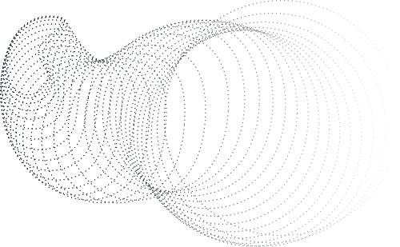
Model Evaluation
Fraud Detection & Analysis
Fraud Visualization
Conclusion
Conclusion
The AI-Based UPI Fraud Detection System is designed to analyze past transaction data and detect fraudulent activities using machine learning models. By processing historical UPI transactions, the system identifies suspicious patterns and flags potential fraud cases.
Key Takeaways:
Data Collection & Preprocessing – We clean and prepare transaction data for analysis.
Feature Selection – Identifying the most important factors that indicate fraud.
Model Training & Prediction – Using ML models like Random Forest, XGBoost, and Logistic Regression to classify transactions as fraudulent or legitimate.
Batch Fraud Detection & Trend Analysis – Detecting fraud across multiple transactions and identifying common fraud patterns.
Fraud Visualization – Using charts and graphs to display fraud trends, high-risk transaction types, and affected locations.
Future Scope:
Real-Time Fraud Detection for instant transaction monitoring.
Deep Learning Integration (LSTM) for better sequential fraud analysis.
Automated Fraud Alerts to notify users and prevent unauthorized transactions.

Slide 15

THANK
YOU

